Slide 1
Y’all are welcome to this Tech program tagged~ 100 days of Code
Our topic is on:

Slide 2
WEB DEVELOPMENT
& my name is
Sarah Imiefase Peter

Slide 3
AIM;
The aim for this session is to encourage those of you that want to step into Web development.

Slide 4
OBJECTIVES:
By the end of this session, you’ll should be able to
Understand the basics of Web Development
Know the Skills in Web Development & where to find such skills
Usefulness of Web Development

Slide 5
CONTENT
This Session should cover the following;
Meaning of Web development
Purpose of Web Development
How Websites work
Types of Web Development
What defines a successful web developer
Careers in Web development
Tools used in Websites( Code Editors )
Responsiveness

Slide 6
Meaning of Web Development
Being a web developer is one of the most interesting career opportunities in the world of Tech because it combines analytical and technical skills with innovative design and development.
Web Development is the building and maintenance of websites. It is also the work or activity that happens behind the scenes to make a website look great, work fast and perform well.
This can be done with different Coding Languages.
Web developers can fit into many organizations such as working with professionals in IT, sales and marketing, and other departments to build websites that attract and keep customers, contributing to a business’s sales growth or even a government agency’s effectiveness.

Slide 7
Note : a website is a group of World Wide Web pages usually containing different links to each other and made available online.There are numerous types of websites each having their own purpose…some include;
e Commerce Websites
Educational Websites
Search Engines
Business Websites
Fashion Websites

Slide 8
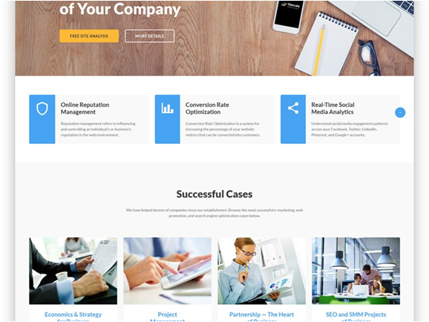

Slide 9
Purpose/Importance of Web Development
Web Development is a way to make people aware of the Services/products one has to offer, understand the benefits of such services or the relevance of the products and even how necessary for them to buy or use.
As a business person, having a website is very essential. Ones voice need to be heard; brand needs to be seen as well as goals need to be reached. Web development is the KEY to making these things possible.

Slide 10
A website helps to prove one’s reliability by offering a straightforward method of showing credibility of a business. With the of Website Development, you can add your skills, credentials, experience, expertise and more in a single place; these details help you earn the trust and confidence from your visitors as well as serve as response point for interested customers.

Slide 11
Another role played by Web Development is in the aspect of Connectivity.
It improves the communication with visitors effectively; comments from your content posted on your site provides you the information about how they feel about the products.

Slide 12
How Websites Work
When users click on a website link, such as a “login” button,(front – end) they rarely think about the underlying code that takes them to a login page . Web developers are responsible for creating the look and feel of that button, as well as the logic that drives the website (back – end).
Computers connected to the web are called CLIENTS and SERVERS. A simplified diagram of how they interact looks like this;

Slide 13
How Websites Work
CLIENT
requests
SERVER
responses

Slide 14
A Client is a Web user’s internet-connected device (such as your computer connected to your Wi-Fi or phone connected to your mobile network ) and web-accessing software i.e web browser such as Firefox, Internet Explorer, Chrome or Google.
A Server is the computer that stores webpages, sites or apps. When a client wants to access a webpage, a copy of the webpage is downloaded from the server onto the client machine to be displayed in the user’s browser.

Slide 15
Types of Web development
There are three types of Web development, namely ;
Front – end web development
Back – end web development
Full – stack web development

Slide 16
A. Front-End Development
Front-End involves what you see in the browser that is, how colours, type, icons and images appear. It also account for how a website looks on all devices (desktops, tablets, phones). It is made up of three types of files; HTML, CSS and Java script. These files are loaded in the browser on the Client’s side. Each of these files have their own pattern of code(Machine Language) on which they relay to.
For the client’s side, a front – end developer has to make sure websites are optimized for clients and search – engines. Also with best security practices in mind.

Slide 17
HTML
HTML →Hyper Text Mark up Language
It is the foundation of all websites. It contains all the content on the page and uses tags to denote different types of content. Such tags can be used to create paragraphs, lists, images and more.

Slide 18
Basic HTML Structure
INPUT
<html>
<head>
<title></title>
</head>
<body>
<h1><u>Hello World</u></h1>
<p>We are good to go</p>
</body>
</html>
OUTPUT
Hello World
We are good to go

Slide 19
CSS
CSS →Cascading Style Sheet
This file helps you style that HTML content so it looks nice and attractive by adding colours, fonts, layouts and other decorative features……
It is essential to have solid CSS skills to specialize in Front-End..

Slide 20
Basic CSS Structure
INPUT
<html>
<head>
<title></title>
</head>
<body style=“background-color:gray;”>
<h1><u>Hello World</u></h1>
<p>We are good to go.</p>
</body>
</html>
OUTPUT
Hello World
We are good to go.

Slide 21
HTML
Hello World
We are good to go
CSS
Hello World
We are good to go.

Slide 22
JAVASCRIPT
This is a programming language that is designed to run in the browser. It makes the web pages more interactive. Using J.S can make your website dynamic meaning it will respond to different inputs from the user or other sources. Some applications/functions include: use of the weather widget, ability to measure temperature, calendar dates and many more. Javascript usually makes use of the <script>.

Slide 23
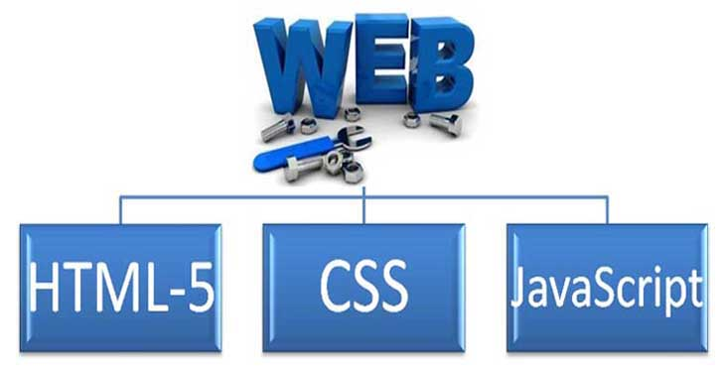
Front-End

Slide 24
B. Back-End Development
The Back-End is all the behind the scene activities that take place in order to make webpages available to the user/client in the browser. It is responsible for building and maintaining the code that runs a website. This code connects the website to the server and ensures that data flows properly correctly. The programming languages for this back – end include Java, PHP and MySQL. Others may include Python and Golang.
It is made up of three main components;
The Server
Server Programming Language
Database

Slide 25
The Server
As mentioned earlier, the server is the computer where all the website files, the data base and other computer are stored and in turn provides information or services to the other computers. Home media servers, web servers and print servers are good examples of types of servers.
In summary, a server stores, sends and receives data

Slide 26
Server Programming Language
On the Server, you need to use a programming language to write the function and logic for your application. The Server in turn complies your code and conveys the results back to the Client. Popular Programming Languages include;
PHP →Hypertext Pre processor
C#
Java
Ruby

Slide 27
Database
A database refers to a collection of logically related information organized so that it can be easily accessible, managed and updated. It is usually controlled by a database management system (DBMS) which are of different types.
A database is where all information is stored for the Website for easy retrieval of this information that may have been lost.….
A programming Language used for this is the SQL( Structured Query Language)
Note:
Within a database, afield contains the most detailed information about events, people, objects and transactions.
A collection of related fields is called a record.
This record(s) put together is called a table
And the collection of related tables makes a DATABASE

Slide 28
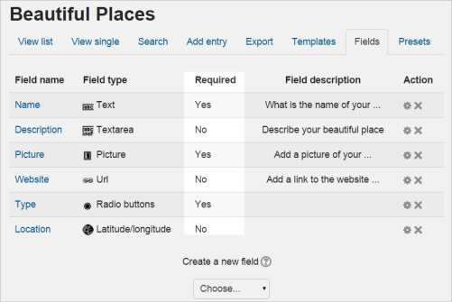

Slide 29
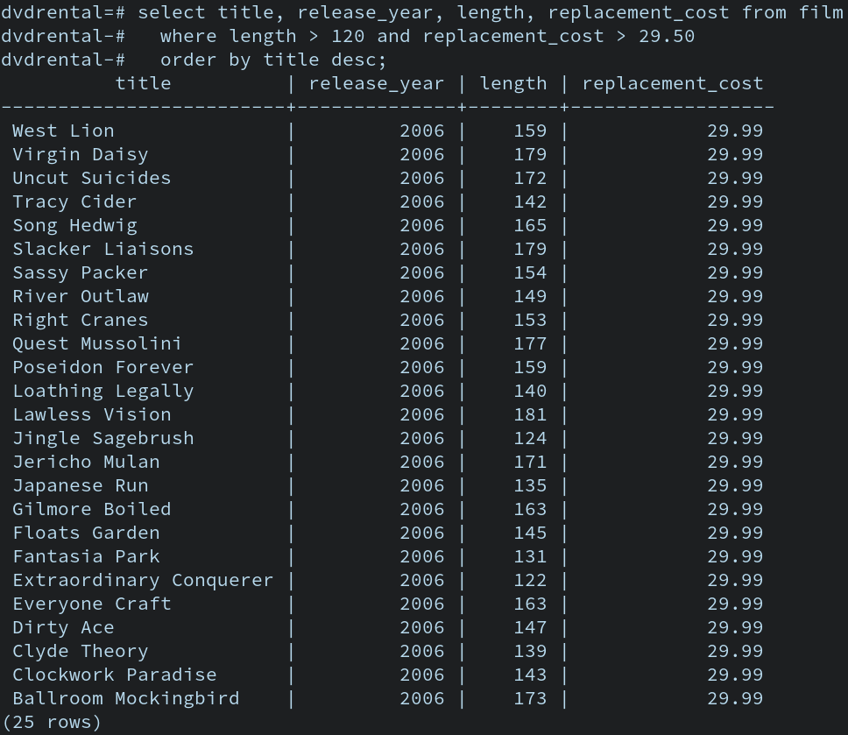

Slide 30
C. Full – stack Development
This covers both front – end and back – end responsibilities. Depending on the complexity of a website, a full – stack developer may be responsible for all side of its development, from the server side to the user interface.
As a full – stack developer, bear in mind there is a lot more to do.

Slide 31
What defines a successful web developer?
The following are skills that can help you advance your career in web development…….
Programming abilities: strong coding skills are very necessary. Mastering programming languages such as HTML and CSS is just a start. Technology changes fast, so a willingness to always learning new coding techniques is important.
Attention to detail: testing and debugging code requires patience and analytical skills to understand that is, what went wrong and how to fix it.
Creative thinking: successful websites have to attract and keep users, as well as be visible to search engines. Web developers have to be creative in how they pull together user experience, search engine optimization, and other factors in building a good site.

Slide 32
Careers in Web development
Web development is very wide and just like we have different types of web development, there are different web development careers requiring different skills. Of course as the saying goes, “a master of all trade is a master of none”. Below are some of the career opportunities in web development;
Web designer (digital designer) is responsible for a website’s look and feel. Having good skills in design, art and coding as well as an understanding of best practices to build a site that is functional, appealing, and successful at drawing users.
Web programmer writes the code that brings a website to life. While the front – end web programmers build the pages the web designer creates, the back – end web programmers write the server code that runs the website. Web programmers are often familiar with web design concepts since they are responsible for making the user interface appealing to site users.
Content developer creates the content that goes on the website. They may include blog posts, product descriptions, images and videos and news stories. Content developers may also have skills in HTML and search engine optimization (SEO) that they use to make sure their websites are best positioned in search results.
Webmaster is responsible for all aspects of an organization’s website, including design, architecture(the way information is organized on the site), coding, security and more. The webmaster works with the programmers, designers and marketing teams to ensure the website is effective at attracting and retaining users and is successful as part of an organization’s business strategy. As a webmaster, you must understand design, coding, sales, and marketing skills.

Slide 33
Code Editors
The most essential tool that will be used in developing a web is the CODE EDITOR. This tool allows you to write the mark up and the code that will make up the website. Some examples of such tools include;
Sublime Text
Atom
Vim
Dream Waver
Notepad++
VS Codes

Slide 34
Responsiveness
This is the process of ensuring that your styles will good on all devices such as desktops, tablets and mobile phones.
It is necessary to make your design responsive for visitors for easy access.

Slide 35

An example of responsive design

